Slide 1
Introduction to C++

Slide 2
The Parts of a C++ Program (1 of 2)
C++ programs have parts and components that serve specific purposes
Let’s examine the C++ program in Figure-1
// sample C++ program
#include <iostream>
using namespace std;
int main()
{
cout << "Hello, world!";
return 0;
}
Figure-1: C++ Program

Slide 3
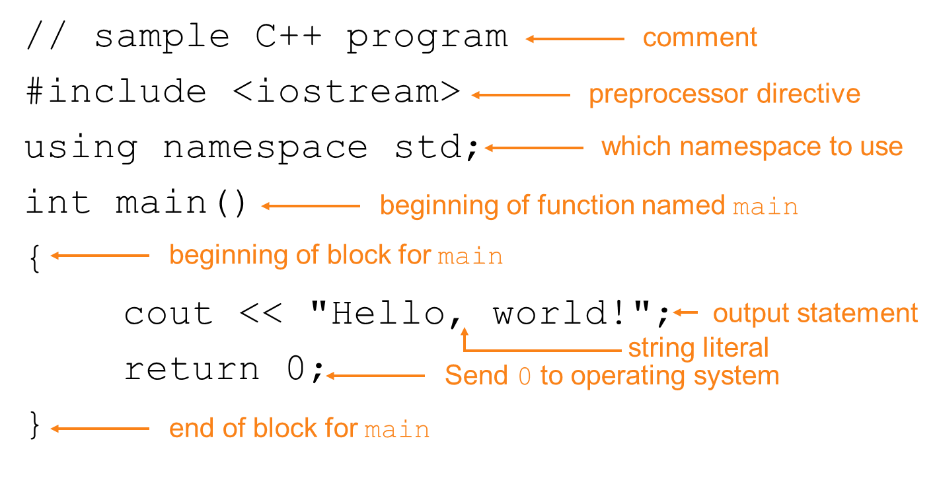
The Parts of a C++ Program (2 of 2)

Slide 4
Comments
The // marks the beginning of a comment.
The C++ compiler ignores everything from the double slash to the end of the line, so they do not cause the computer to perform any action when the C++ program executes.
A comment that begins with // is called a single-line comment, because it terminates at the end of the line on which it appears.
A // comment also can begin in the middle of a line and continue until the end of that line.
Delimited comments begin with the delimiter /* and end with the delimiter */. All text between the delimiters is ignored by the compiler

Slide 5
Special Characters
Character | Name | Meaning
// | Double slash | Beginning of a comment
# | Pound sign | Beginning of preprocessor directive
< > | Open/close brackets | Enclose filename in #include
( ) | Open/close parentheses | Used when naming a function
{ } | Open/close brace | Encloses a group of statements
" " | Open/close quotation marks | Encloses string of characters
; | Semicolon | End of a programming statement

Slide 6
The cout Object (1 of 3)
Displays output on the computer screen
Programmer use the stream insertion operator << to send output to cout:
cout << "Programming is fun!";

Slide 7
The cout Object (2 of 3)
Can be used to send more than one item to cout:
cout << "Hello " << "there!";
Or:
cout << "Hello ";
cout << "there!";

Slide 8
The cout Object (3 of 3)
This produces one line of output:
cout << "Programming is "; cout << "fun!";

Slide 9
The endl Manipulator (1 of 3)
You can use the endl manipulator to start a new line of output. This will produce two lines of output:
cout << "Programming is" << endl; cout << "fun!";

Slide 10
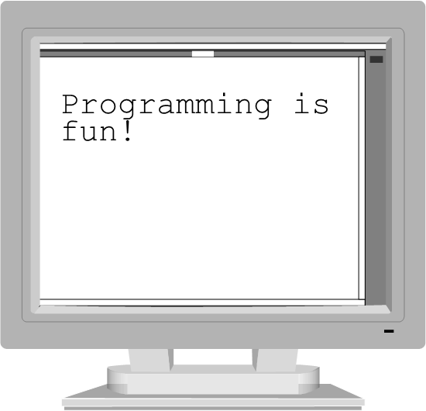
The endl Manipulator (2 of 3)
cout << "Programming is" << endl; cout << "fun!";

Slide 11

The endl Manipulator (3 of 3)
You do NOT put quotation marks around endl
The last character in endl is a lowercase L, not the number 1.

Slide 12
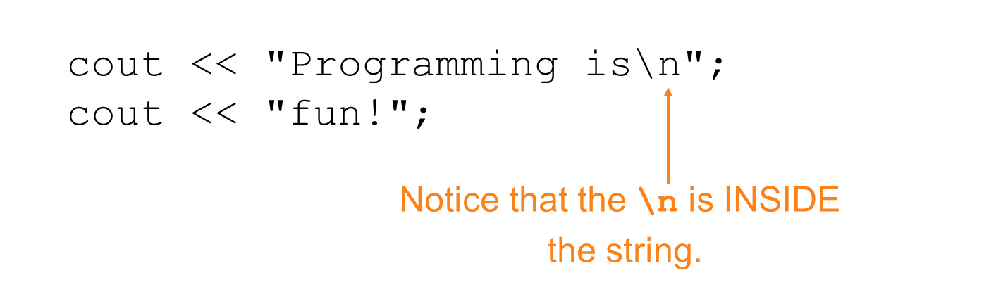
The \n Escape Sequence (1 of 2)
You can also use the \n escape sequence to start a new line of output. This will produce two lines of output:

Slide 13
The \n Escape Sequence (2 of 2)
cout << "Programming is\n"; cout << "fun!";

Slide 14
The #include Directive
Inserts the contents of another file into the program
This is a preprocessor directive, not part of C++ language
#include lines not seen by compiler
Do not place a semicolon at end of #include line

Slide 15
Variables and Literals
Variable: a storage location in memory
Has a name and a type of data it can hold
Must be defined before it can be used:
int item;

Slide 16
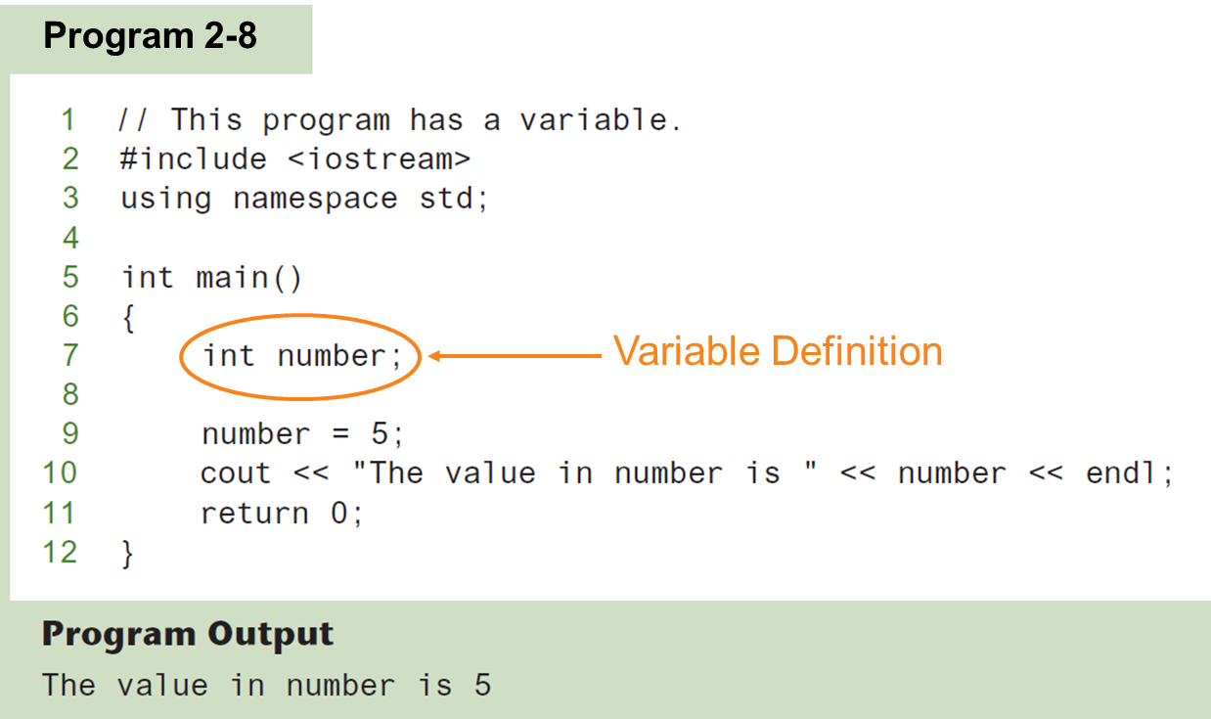
Variable Definition

Slide 17
Literals
Literal: a value that is written into a program’s code.
"hello, there" (string literal)
12 (integer literal)

Slide 18
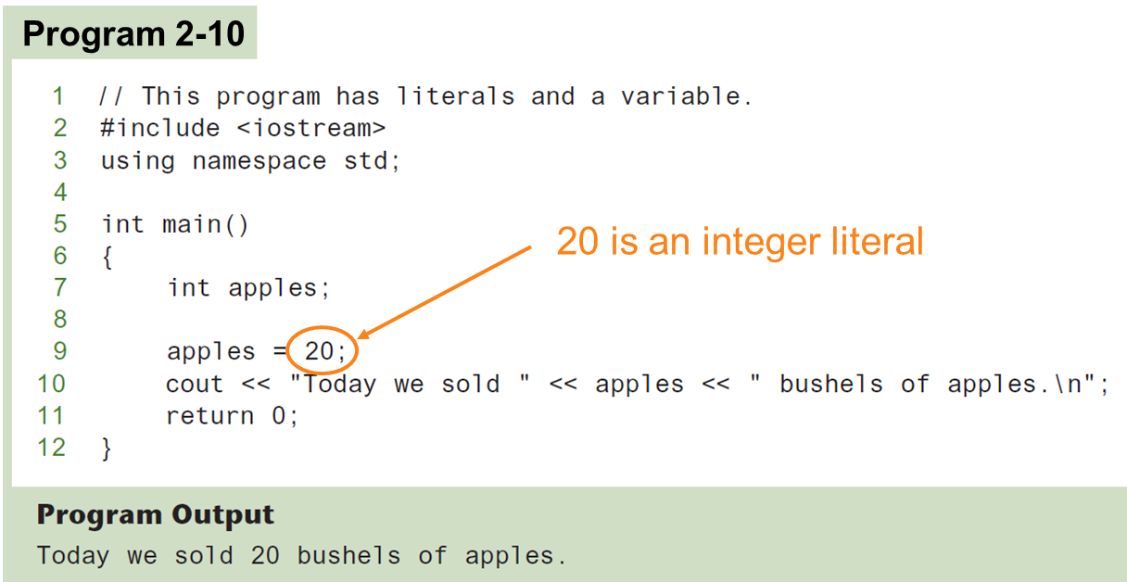
Integer Literal

Slide 19
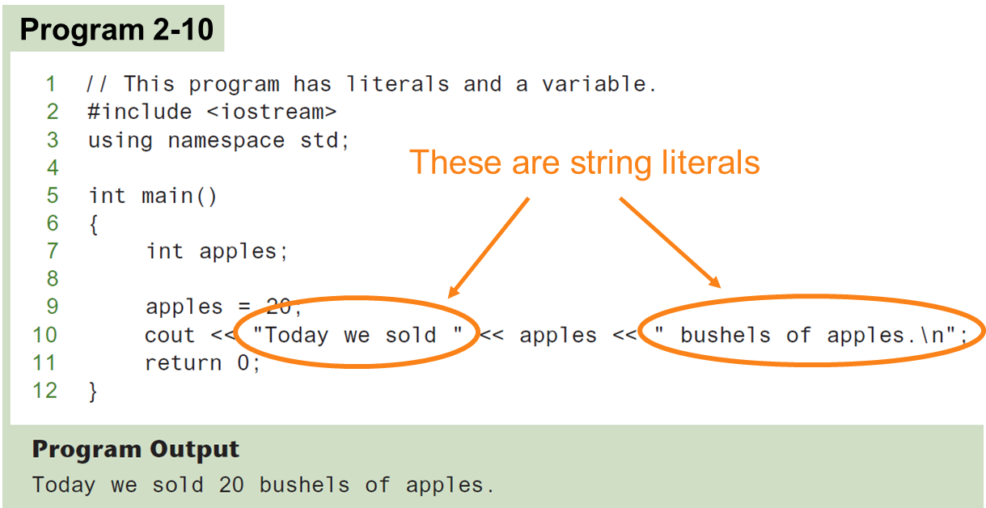
String Literals

Slide 20
Identifiers
An identifier is a programmer-defined name for some part of a program: variables, functions, etc.

Slide 21
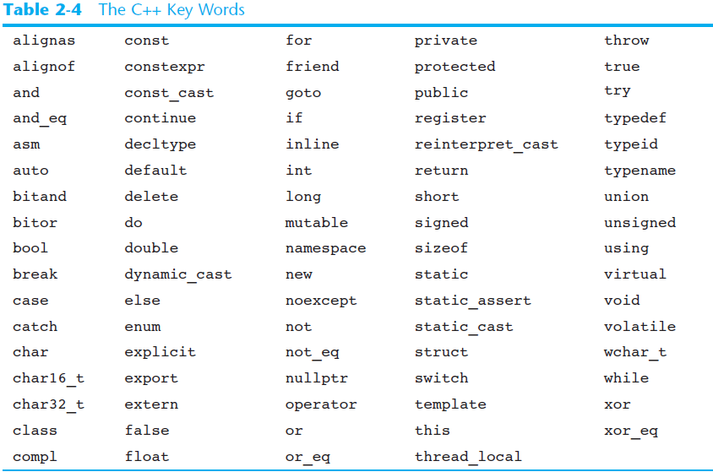
C++ Key Words
You cannot use any of the C++ key words as an identifier. These words have reserved meaning.

Slide 22
Variable Names
A variable name should represent the purpose of the variable. For example:
itemsOrdered
The purpose of this variable is to hold the number of items ordered.

Slide 23
Identifier Rules
The first character of an identifier must be an alphabetic character or and underscore ( _ ),
After the first character you may use alphabetic characters, numbers, or underscore characters.
Upper- and lowercase characters are distinct

Slide 24
Valid and Invalid Identifiers
IDENTIFIER | VALID? | REASON IF INVALID
totalSales | Yes | Blank cell
total_Sales | Yes | Blank cell
total.Sales | No | Cannot contain .
4thQtrSales | No | Cannot begin with digit
totalSale$ | No | Cannot contain $

Slide 25
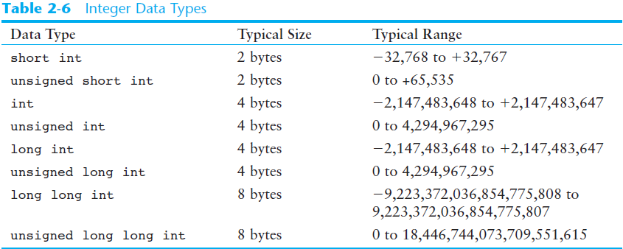
Integer Data Types
Integer variables can hold whole numbers such as 12, 7, and −99.

Slide 26
Defining Variables
Variables of the same type can be defined
On separate lines:
int length;
int width;
unsigned int area;
On the same line:
int length, width;
unsigned int area;
Variables of different types must be in different definitions

Slide 27
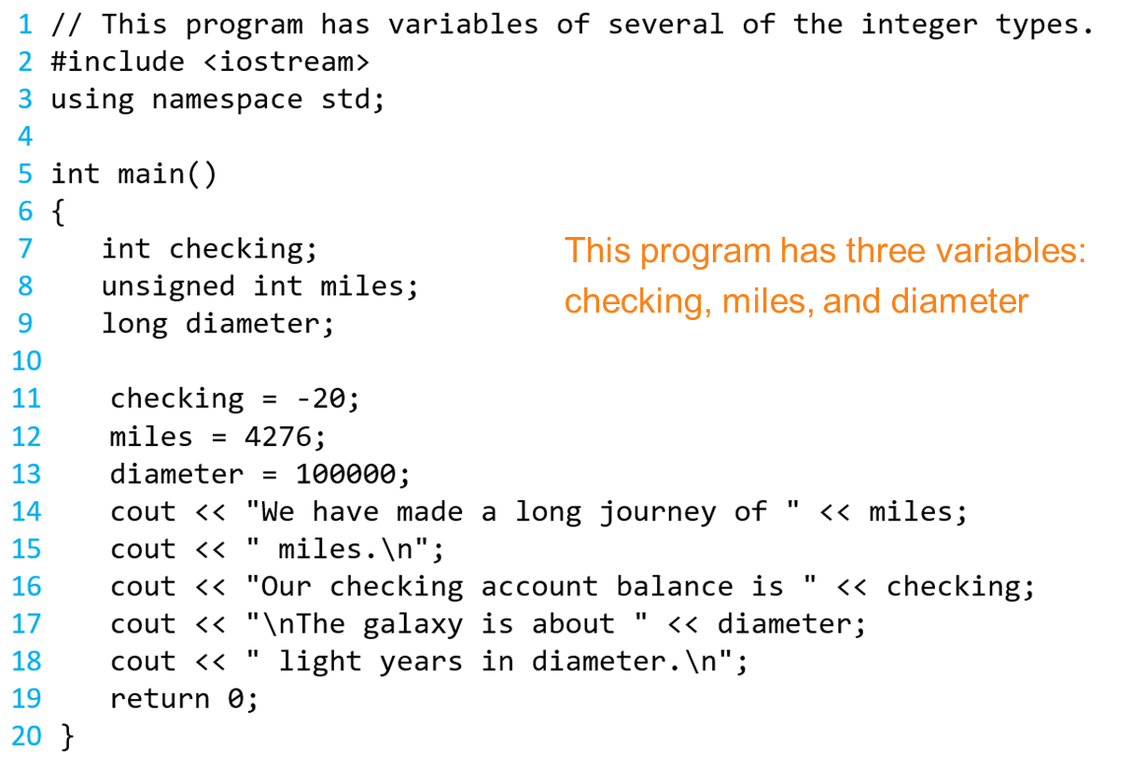
Integer Types in Program 2-11

Slide 28
Integer Literals (1 of 2)
An integer literal is an integer value that is typed into a program’s code. For example:
itemsOrdered = 15;
In this code, 15 is an integer literal.

Slide 29
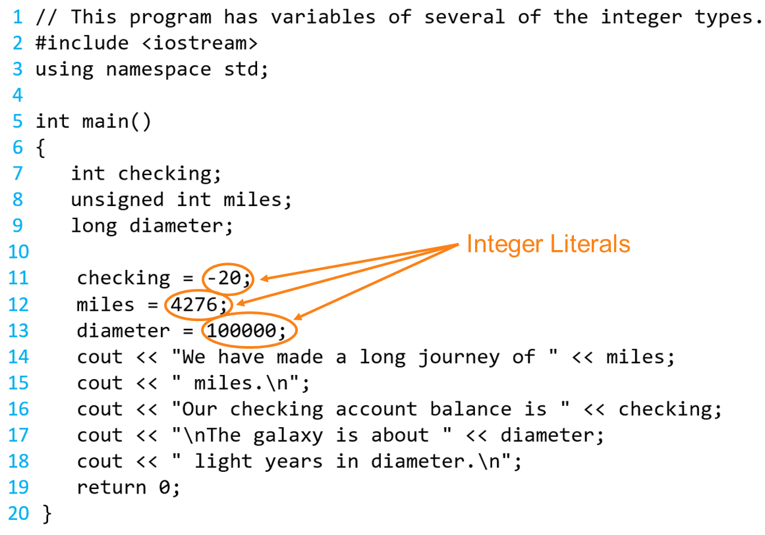
Integer Literals in Program 2-11

Slide 30
Integer Literals (2 of 2)
Integer literals are stored in memory as ints by default
To store an integer constant in a long memory location, put ‘L’ at the end of the number: 1234L
To store an integer constant in a long long memory location, put ‘LL’ at the end of the number: 324LL
Constants that begin with ‘0’ (zero) are base 8: 075
Constants that begin with ‘0x’ are base 16: 0x75A

Slide 31
The char Data Type
Used to hold characters or very small integer values
Usually 1 byte of memory
Numeric value of character from the character set is stored in memory:
CODE:
char letter;
letter = 'C';
MEMORY: letter
67

Slide 32
Character Literals (1 of 2)
Character literals must be enclosed in single quote marks. Example:
'A'

Slide 33
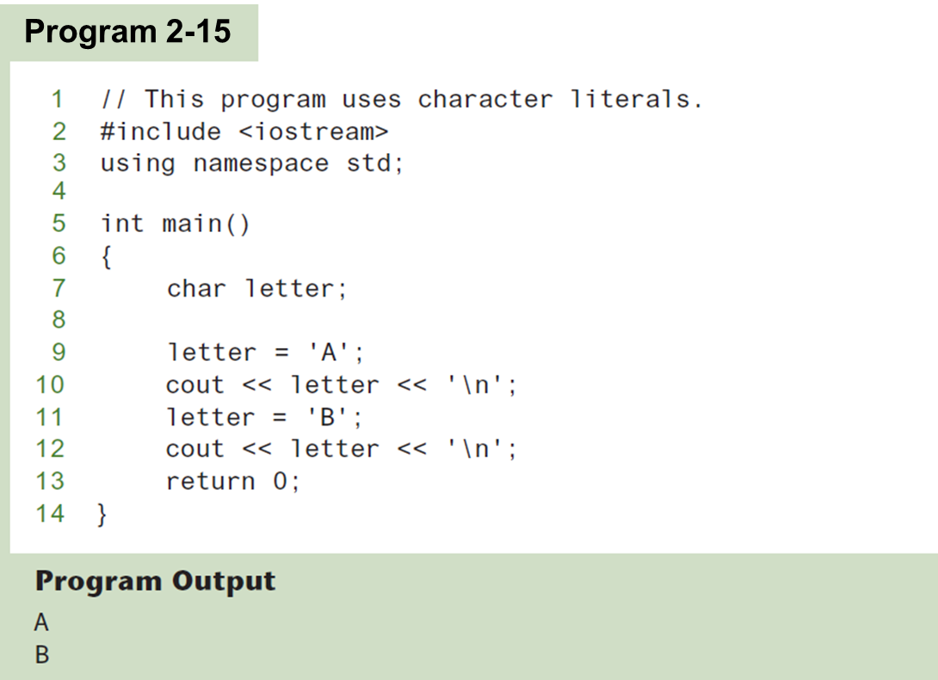
Character Literals (2 of 2)

Slide 34
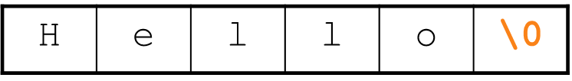
Character Strings
A series of characters in consecutive memory locations:
"Hello"
Stored with the null terminator, \0, at the end:
Comprised of the characters between the " "

Slide 35
The C++ string Class
Special data type supports working with strings
#include <string>
Can define string variables in programs:
string firstName, lastName;
Can receive values with assignment operator:
firstName = "George";
lastName = "Washington";
Can be displayed via cout
cout << firstName << " " << lastName;

Slide 36
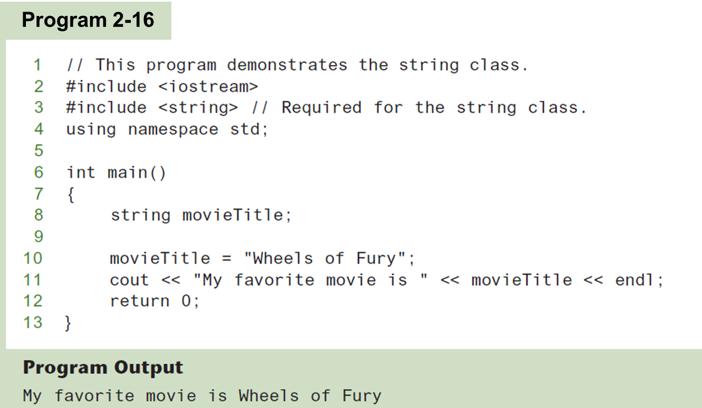
The string Class

Slide 37
Floating-Point Data Types (1 of 2)
The floating-point data types are: float double long double
They can hold real numbers such as:
12.45 -3.8
Stored in a form similar to scientific notation
All floating-point numbers are signed

Slide 38
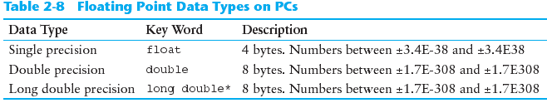
Floating-Point Data Types (2 of 2)

Slide 39
Floating-Point Literals
Can be represented in
Fixed point (decimal) notation:
31.4159 0.0000625
E notation:
3.14159E1 6.25e-5
Are double by default
Can be forced to be float (3.14159f) or long double (0.0000625L)

Slide 40
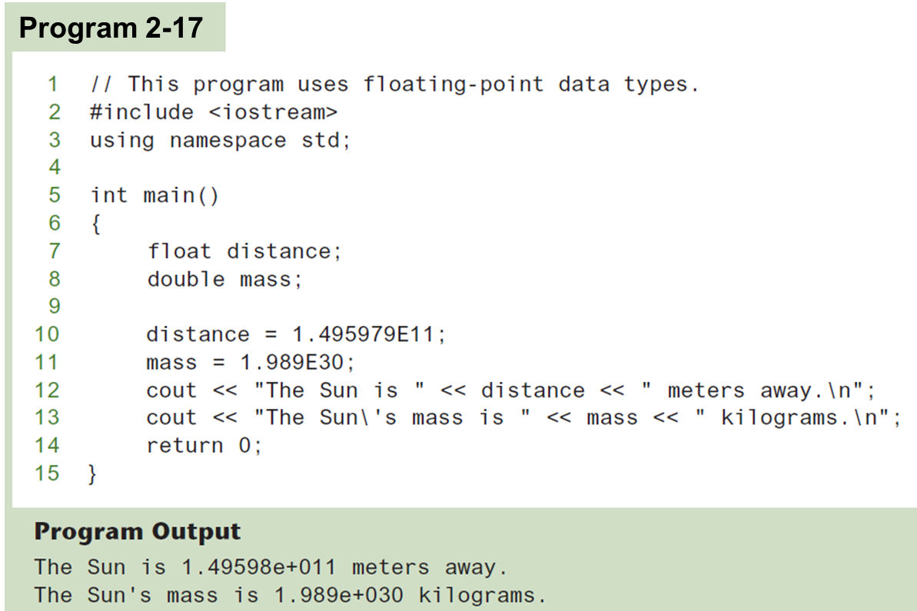
Floating-Point Data Types in Program 2-17

Slide 41
The bool Data Type
Represents values that are true or false
bool variables are stored as small integers
false is represented by 0, true by 1:
bool allDone = true;
bool finished = false;
allDone
finished
1
0

Slide 42
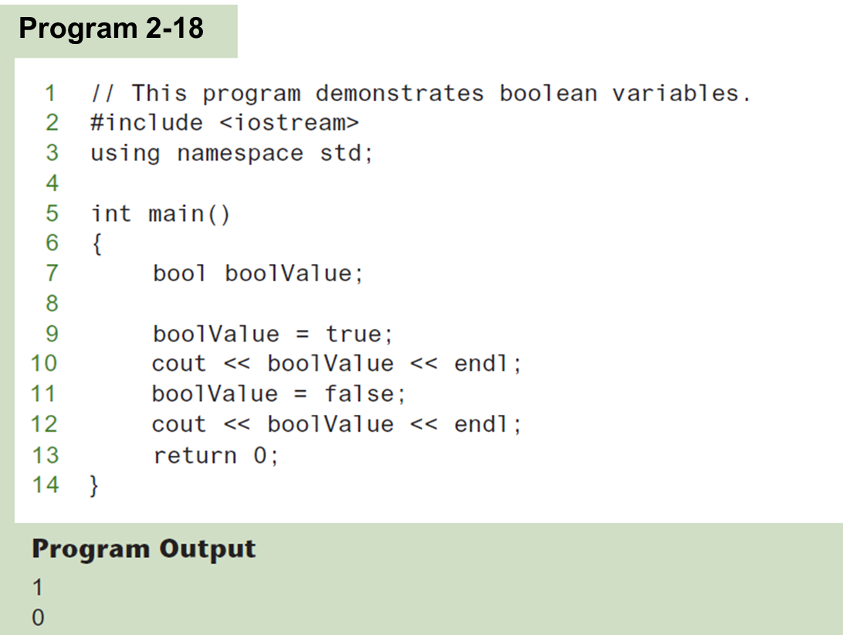
Boolean Variables

Slide 43
Determining the Size of a Data Type
The sizeof operator gives the size of any data type or variable:
double amount;
cout << "A double is stored in "
<< sizeof(double) << "bytes\n";
cout << "Variable amount is stored in "
<< sizeof(amount)
<< "bytes\n";

Slide 44
Variable Assignments and Initialization
An assignment statement uses the = operator to store a value in a variable.
item = 12;
This statement assigns the value 12 to the item variable.

Slide 45
Assignment
The variable receiving the value must appear on the left side of the = operator.
This will NOT work:
// ERROR! 12 = item;

Slide 46
Variable Initialization (1 of 2)
To initialize a variable means to assign it a value when it is defined:
int length = 12;
Can initialize some or all variables:
int length = 12, width = 5, area;

Slide 47
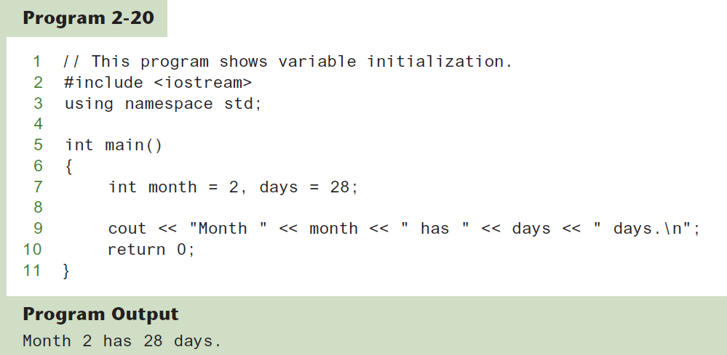
Variable Initialization (2 of 2)

Slide 48
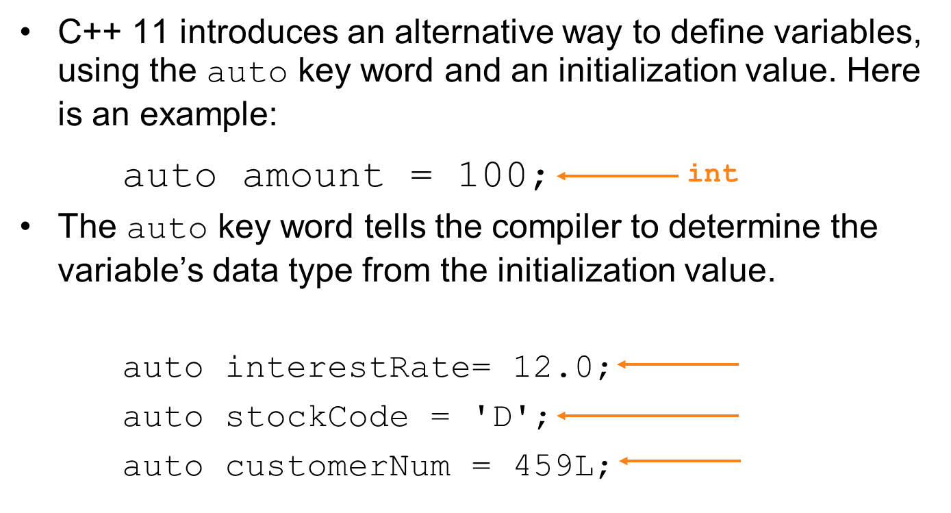
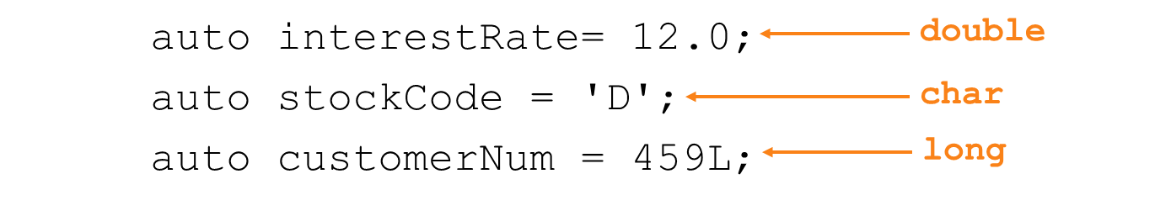
Declaring Variables With the auto Key Word
C++ 11 introduces an alternative way to define variables, using the auto key word and an initialization value. Here is an example:
The auto key word tells the compiler to determine the variable’s data type from the initialization value.

Slide 49
Scope
The scope of a variable: the part of the program in which the variable can be accessed
A variable cannot be used before it is defined

Slide 50
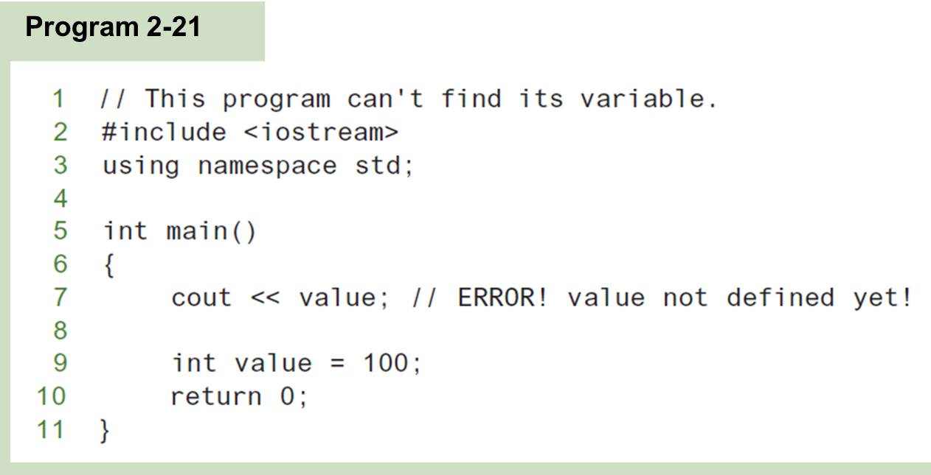
Variable Out of Scope

Slide 51
Arithmetic Operators (1 of 2)
Used for performing numeric calculations
C++ has unary, binary, and ternary operators:
unary (1 operand) -5
binary (2 operands) 13 - 7
ternary (3 operands) exp1 ? exp2 : exp3

Slide 52
Binary Arithmetic Operators
SYMBOL | OPERATION | EXAMPLE | VALUE OF ans
+ | addition | ans = 7 + 3; | 10
- | subtraction | ans = 7 - 3; | 4
* | multiplication | ans = 7 * 3; | 21
/ | division | ans = 7 / 3; | 2
% | modulus | ans = 7 % 3; | 1

Slide 53
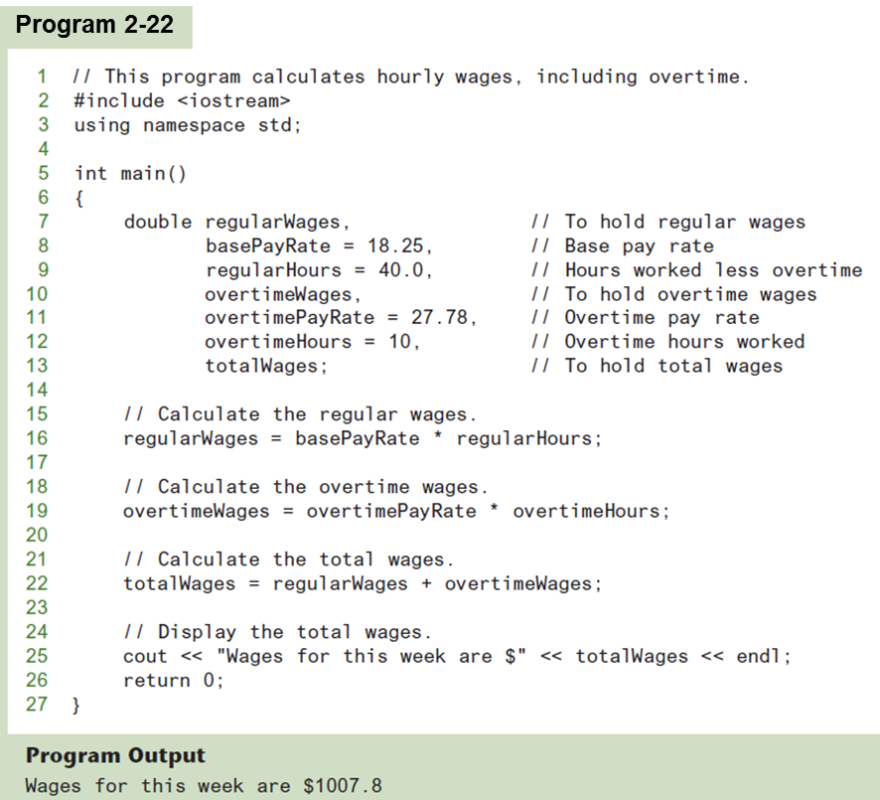
Arithmetic Operators (2 of 2)

Slide 54
A Closer Look at the / Operator
/ (division) operator performs integer division if both operands are integers
cout << 13 / 5; // displays 2
cout << 91 / 7; // displays 13
If either operand is floating point, the result is floating point
cout << 13 / 5.0; // displays 2.6
cout << 91.0 / 7; // displays 13.0

Slide 55
A Closer Look at the % Operator
% (modulus) operator computes the remainder resulting from integer division
cout << 13 % 5; // displays 3
% requires integers for both operands
cout << 13 % 5.0; // error

Slide 56
Comments
Used to document parts of the program
Intended for persons reading the source code of the program:
Indicate the purpose of the program
Describe the use of variables
Explain complex sections of code
Are ignored by the compiler

Slide 57
Single-Line Comments
Begin with // through to the end of line:
int length = 12; // length in inches
int width = 15; // width in inches
int area; // calculated area
// calculate rectangle area
area = length * width;

Slide 58
Multi-Line Comments
Begin with /*, end with */
Can span multiple lines:
/* this is a multi-line
comment
*/
Can begin and end on the same line:
int area; /* calculated area */

Slide 59
Named Constants
Named constant (constant variable): variable whose content cannot be changed during program execution
Used for representing constant values with descriptive names:
const double TAX_RATE = 0.0675;
const int NUM_STATES = 50;
Often named in uppercase letters

Slide 60
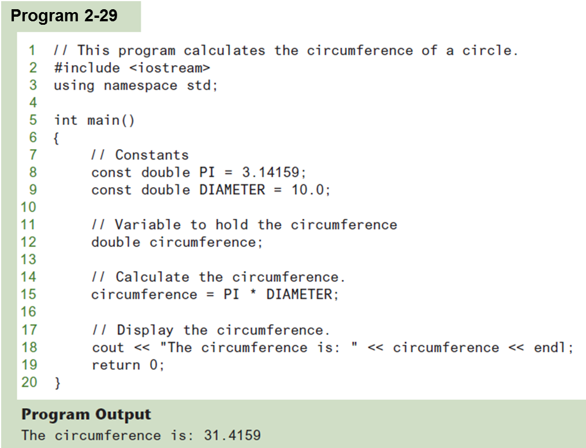
Named Constants in Program 2-28

Slide 61
Programming Style
The visual organization of the source code
Includes the use of spaces, tabs, and blank lines
Does not affect the syntax of the program
Affects the readability of the source code

